Slide 1
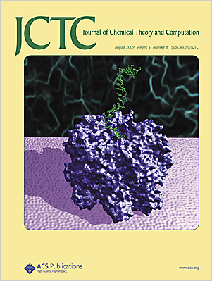
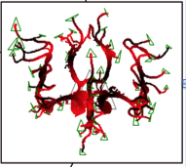






Expeditions in Computational Biology on Production Distributed CI
Shantenu Jha
http://saga-project.org

Slide 2

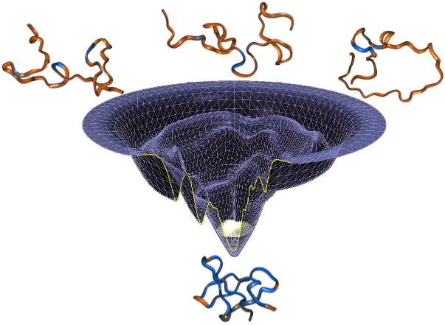
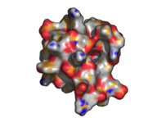
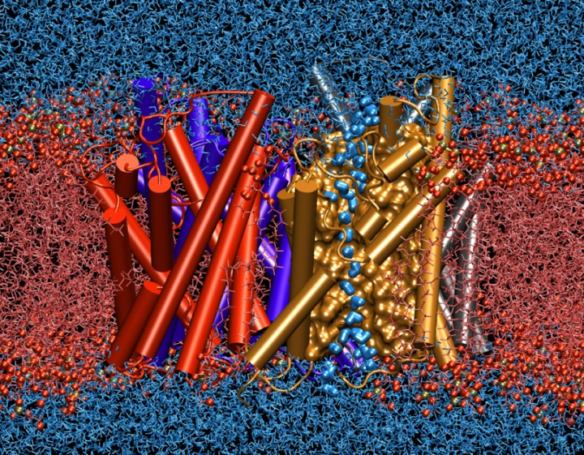
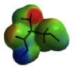
The Challenge of Scale: Time and Size
mins
Coarse-Grained Simulations
s
ms
Assembly Level
μs
Molecular Dynamics (atomistic)
Time (real)
ns
Molecular Level
ps
QM
Electronic Level
fs
0 10 10² 10³ 10⁴ 10⁵ 10⁶ 10^{7 ....}
Size of the System
(# of atoms)
Notes:
Recurring theme

Slide 3
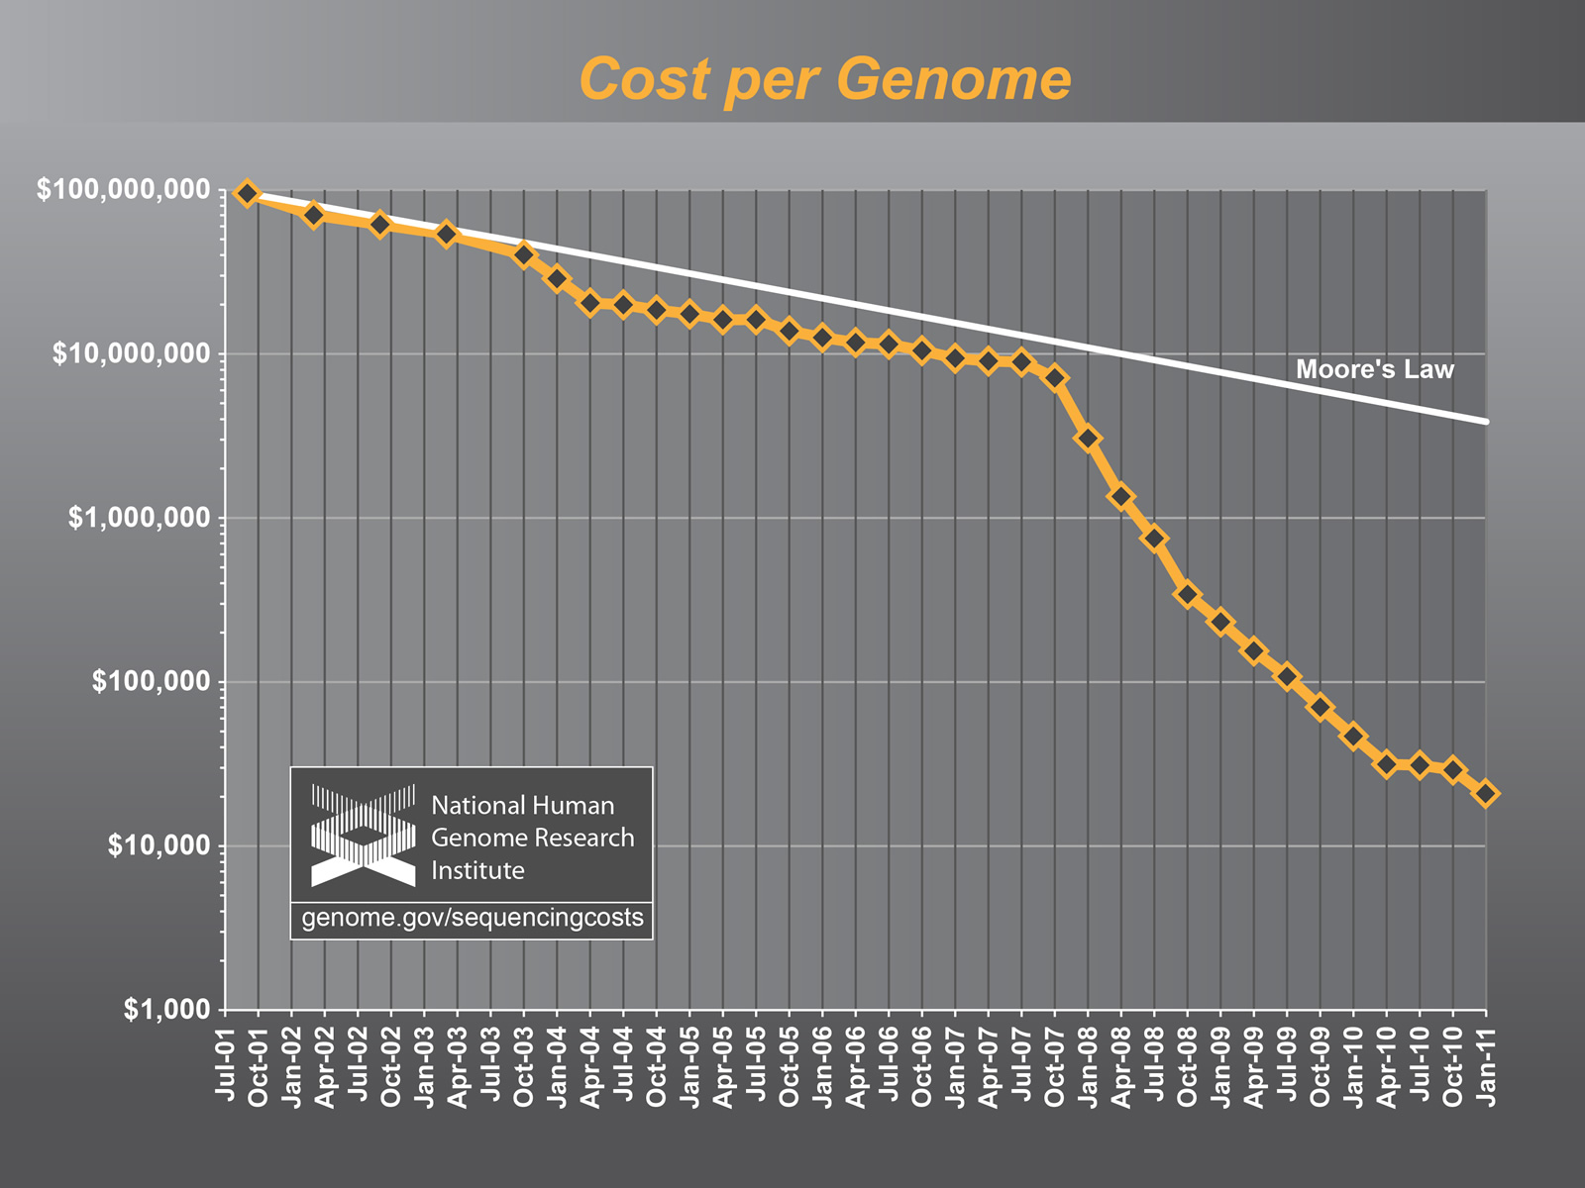
The Challenge of Integrating Compute and Data CI

Slide 4
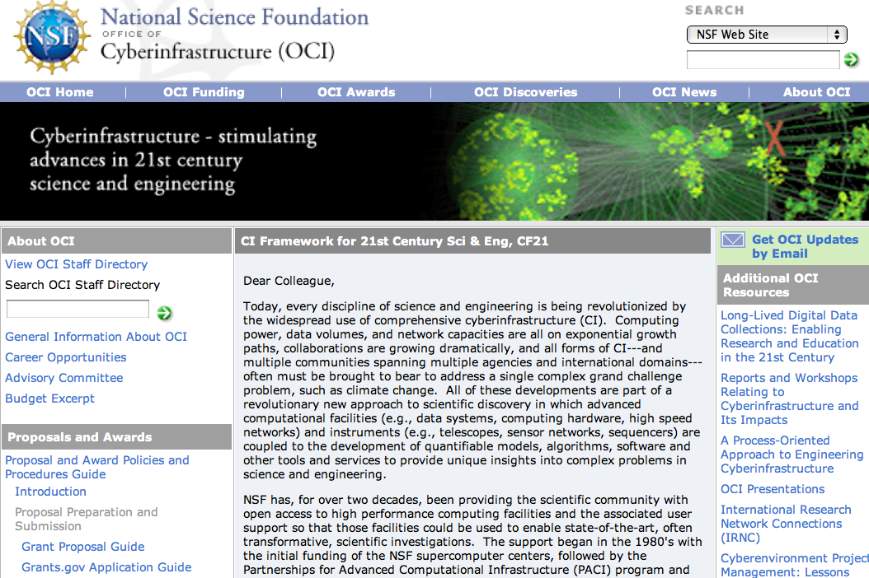
Cyberinfrastructure Framework for 21st Century Science and Engineering -- CF21
http://www.nsf.gov/pubs/2010/nsf10015/nsf10015.pdf

Slide 5
Overview
Introducing Production Distributed CI
Formalisms, Infrastructure and Algorithms
Formalism: Scale-Out AND Scale-Up
SPICE: Configurational Sampling & Free-energy Calculations
Infrastructure: MD Studies of Nucleosome Positioning
HT-HPC, SAGA and Pilot-Jobs
Algorithms: Adaptive Replica-Exchange
Other Examples:
Personalized and Predictive Medicine
Personalised Health: Interactive (Steering) Supercomputing
Personalised HIV Treatment
Distributed Data-Intensive Biological Applications
Supporting Next Generation Sequencing (NGS) Analytics
Notes:
Delicate balancing act: --- vision of the future but rooted in reality – with rigorous research.
Be sure to define “applications” – eScience, scientific applications…

Slide 6
TeraGrid US National Cyberinfrasctructure for Scientific Research

Slide 7
11 Resource Providers
Grid Infrastructure Group (UChicago)
UW
UC/ANL
PSC
NCAR
PU
NCSA
Caltech
IU
UNC/RENCI
ORNL
USC/ISI
NICS
SDSC
LONI
TACC
Resource Provider (RP)
Software Integration Partner

Slide 8
TERAGRID XSEDE US National Cyberinfrasctructure for Scientific Research

Slide 9
What is XSEDE?
Is a distributed “grid” facility, managed like a large cooperative research group, not a consortium:
One coordinating XSEDE award (little hardware, backbone network)
~10 initial evolving service provider “SP” infrastructure awards
XSEDE coordination award provides single:
Portal, sign-on, help desk, allocations process, advanced user support, EOT, campus champions, coordinated software, integration process
The SP awards include:
Large tightly coupled distributed memory clusters
Ranger (TACC) 579 TF, Kraken (NICS) > 1 PF
Large share memory machines
Clusters with Infiniband; Condor pools
Viz, Storage, and experimental (FutureGrid) resources
Targets US based open science research (NSF primarily)

Slide 10
XSEDE’s Distinguishing Characteristics
Foundation for a national cyberinfrastructure ecosystem
comprehensive suite of advanced digital services will federate with other high-end facilities and campus-based resources
Unprecedented integration of diverse digital resources
innovative, open architecture making possible the continuous addition of new technology capabilities and services

Slide 11
XSEDE’s Distinguishing Characteristics – User Services
Unified and comprehensive user support services
designed to advance science and engineering
provided by experts in the application of technology
new and expanded facets of advanced support
external shorter-term contracting for expertise beyond that in current team; Novel and Innovative Projects
More mature operational practices
increased focus on productivity and ease of use
increased and enhanced security, reliability, and quality assurance

Slide 12
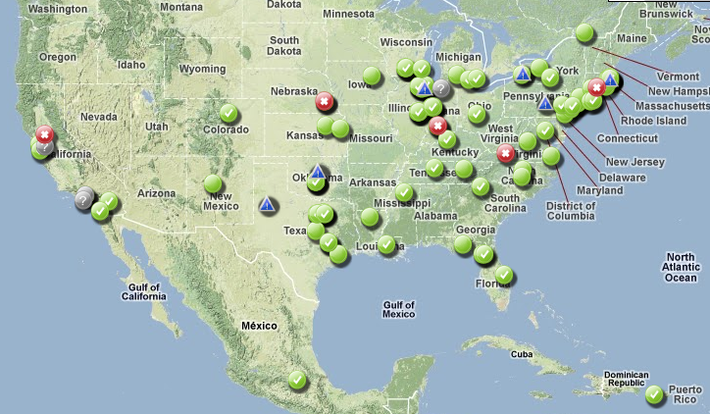
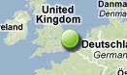
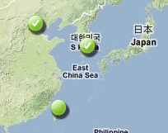
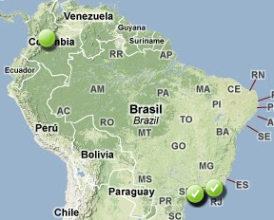
Some of the OSG Sites

Slide 13
TeraGrid & OSG Resources
 | OSG | TeraGrid
HPC Resources | Some have Myrinet/Infiniband | 12
HPC TeraFlops |  | >2 PF
HPC Processor |  | >200K CPUs
HTC Resources | ~93 compute elements | 4
HTC Processors | 421M CPU hours/year Typical ~70K CPUs in use | >27K CPUs
Storage | ~31 PB | 3 PB disk + 60 PB tape
Network | varies, shared Internet2 | dedicated 10 Gbps
Visualization |  | 4 resources
Other |  | VMs, GPUs, FPGAs

Slide 14
OSG Software
OSG Software Stack (a.k.a VDT)
Set of software components shared across OSG
Built, packaged, tested, and distributed as coherent software distribution
Major components
Compute Element
Accepts jobs to site
Has accounting, authentication/authorization, information services, and utilities
Storage Element
Manages storage at site
Has accounting, authentication/authorization, information services, and utilities
Worker Node
Software required at each worker node (basic client tools…)
Client
Software used to submit to OSG
Condor-G, data clients, security clients, etc…

Slide 15
XSEDE Architecture
Applications, Portals and Gateways, XUAS
Transparent access via the file system
APIs and CLIs
Access Layer
Services &
Web Services
Infrastructure
XSEDE Enterprise
Services
GridFTP
GRAM5
Community Provided
Services
JSDL/BES
HPC-BP
REST/RMI
Amazon EC2
WSI-BSP
RNS/ByteIO
Application Deployment
Core Enterprise
Resources, e.g.,
RP resources
Other Resources, e.g.
Campus centers, Amazon,
Research group data
Resources

Slide 16
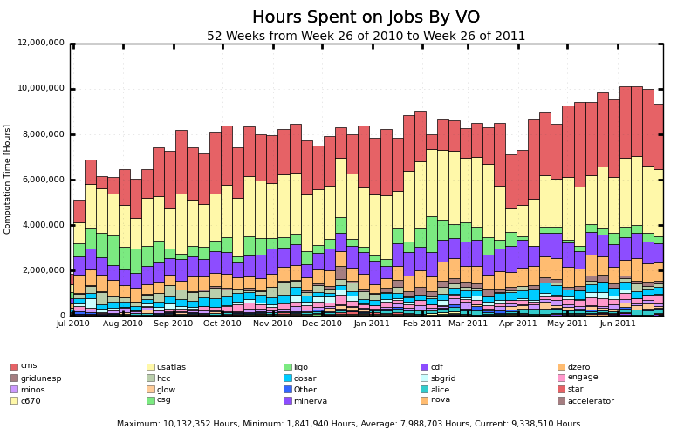
Some OSG Job stats
Average: ~3,500,000 jobs/week

Slide 17
TeraGrid Usage
Advanced
Earth Sciences
19 Others
Scientific
5%
4%
Computing
6%
Physics
Materials
26%
Research
6%
Chemical,
Thermal
Systems
6%
Chemistry
7%
Molecular
Biosciences
Atmospheric
18%
Sciences
8%
Astronomical
Sciences
14%
>27B NUs Delivered in 2009
Over 1,200 projects supported

Slide 18
How TeraGrid Is Used
Use Modality | Community Size (rough est. - number of users)
Batch Computing on Individual Resources | 850
Exploratory and Application Porting | 650
Workflow, Ensemble, and Parameter Sweep | 250
Science Gateway Access | 500
Remote Interactive Steering and Visualization | 35
Tightly-Coupled Distributed Computation | 10
2006 data

Slide 19
Distributed Applicatoins IDEAS: Development Objectives
Interoperability: Ability to work across multiple distributed resources
Distributed Scale-Out: The ability to utilize multiple distributed resources concurrently
Extensibility: Support new abstractions, different programming systems, infrastructure
Adaptivity: Response to fluctuations in dynamic resource and availability of dynamic data
Simplicity: Accommodate above distributed concerns at different levels easily…
Challenge: How to develop DA that are effective and efficient with the above as first-class objectives?

Slide 20
Overview
Introducing Production Distributed CI
Formalisms, Infrastructure and Algorithms
Formalism: Scale-Out AND Scale-Up
SPICE: Configurational Sampling & Free-energy Calculations
Infrastructure: MD Studies of Nucleosome Positioning
HT-HPC, SAGA and Pilot-Jobs
Algorithms: Adaptive Replica-Exchange
Other Examples:
Personalized and Predictive Medicine
Personalised Health: Interactive (Steering) Supercomputing
Personalised HIV Treatment
Distributed Data-Intensive Biological Applications
Supporting Next Generation Sequencing (NGS) Analytics
Notes:
Delicate balancing act: --- vision of the future but rooted in reality – with rigorous research.
Be sure to define “applications” – eScience, scientific applications…

Slide 21
Free Energy Calculations
High Accuracy
Low Accuracy
FEP/TI
cv-SMD
ABF
MM-PBSA
LIE…
Low
Computational cost
High
Computational cost
LIE = Linear Integration Energies; MM-PBSA = Molecular Mechanics, Poisson Boltzmann, solvent accessible Surface Area;
TI = Thermodynamic Integration; FEP = Free Energy Perturbation;
ABF = Adaptive Biasing Force; cv-SMD = constant vel. Steered Molecular Dynamics

Slide 22
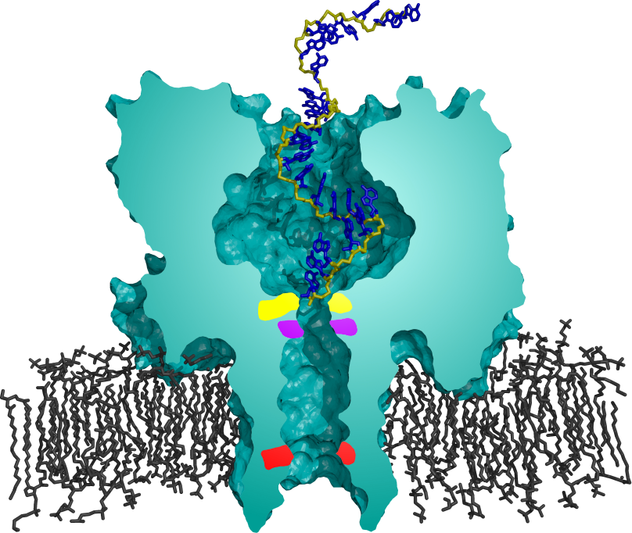
DNA/RNA Transport through Alpha-Hemolysin (αHL)
Fundamental process: mRNA transport, infections, biotech
Need to understand microscopic basis
7 monomeric units form heptamer pore on lipid membranes
Pore allows only single-stranded nucleic acid chains to pass
Ideal for DNA/RNA single channel current recordings
A

Slide 23
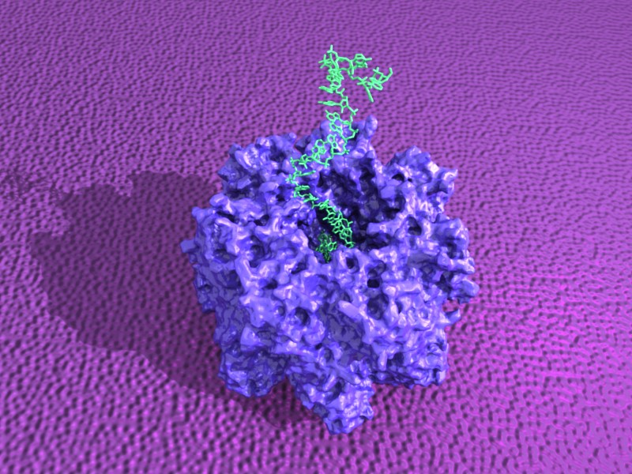
DNA/RNA Transport through Alpha-Hemolysin (αHL)
Fundamental process: mRNA transport, infections, biotech
Need to understand microscopic basis
7 monomeric units form heptamer pore on lipid membranes
Pore allows only single-stranded nucleic acid chains to pass
Ideal for DNA/RNA single channel current recordings
A

Slide 24
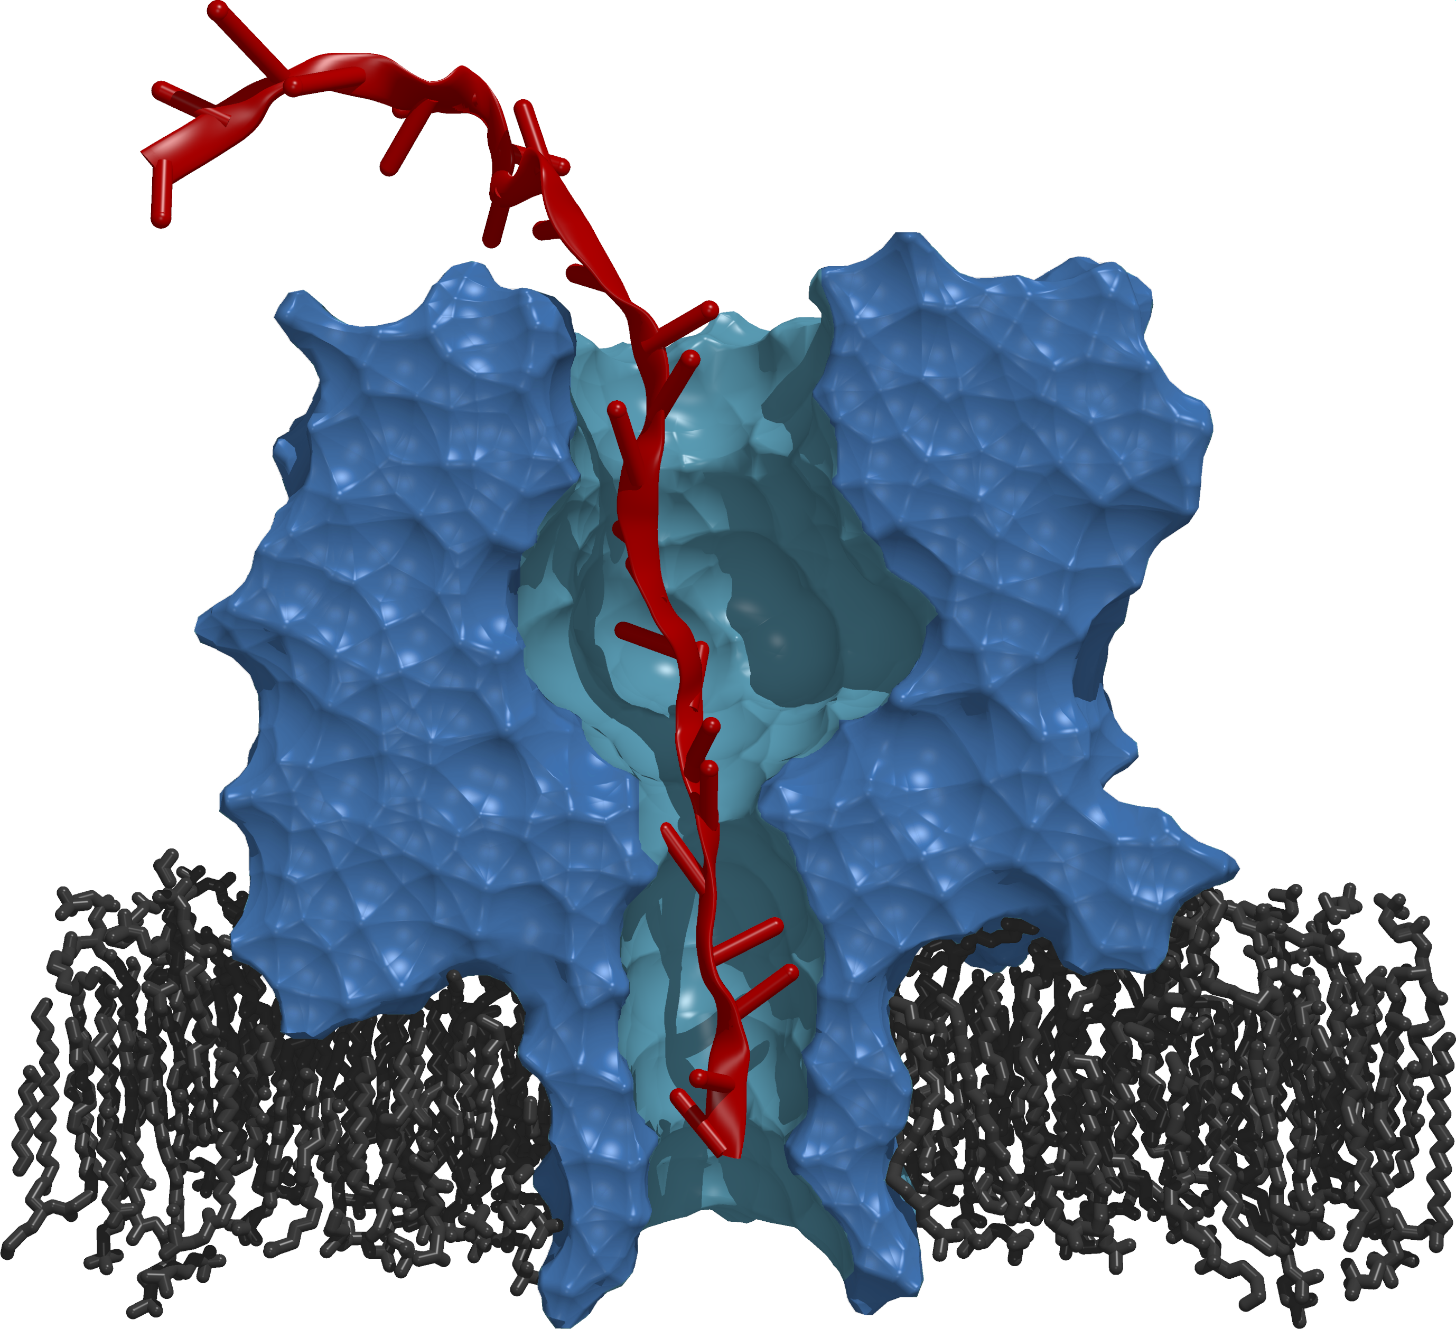
Computational Model
Mutations
Fully Atomistic. ~330K atoms.
Single stranded DNA translocation through αHL
A cross-section of the protein pore αHL is depicted in blue.
Red represents a single strand of DNA (3’ end at the bottom)
Black represents the lipid bilayer.
The DNA strand is dragged from the cis (top) entrance to the trans (bottom) entrance.

Slide 25
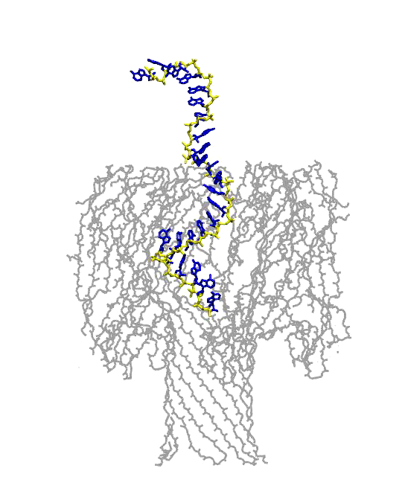
Computational Model
Mutations
Fully Atomistic. ~330K atoms.
Single stranded DNA translocation through αHL
A cross-section of the protein pore αHL is depicted in blue.
Red represents a single strand of DNA (3’ end at the bottom)
Black represents the lipid bilayer.
The DNA strand is dragged from the cis (top) entrance to the trans (bottom) entrance.

Slide 26
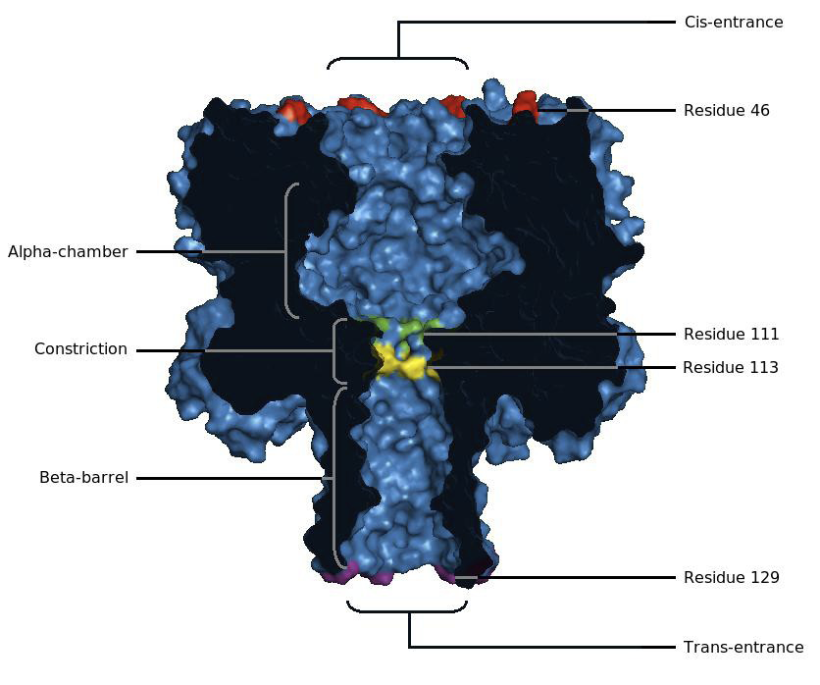
Model: Atomistic-level Detail
28A

Slide 27
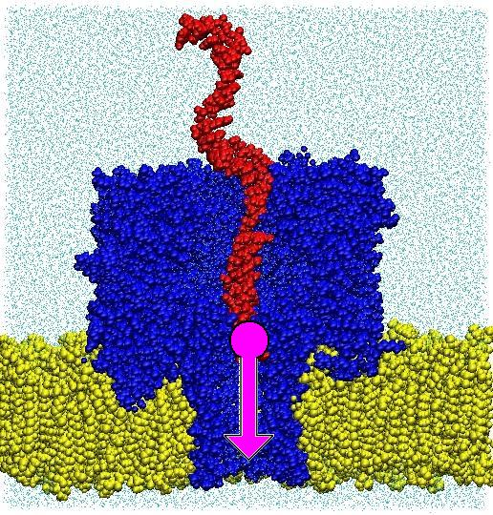
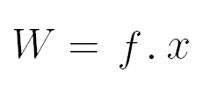
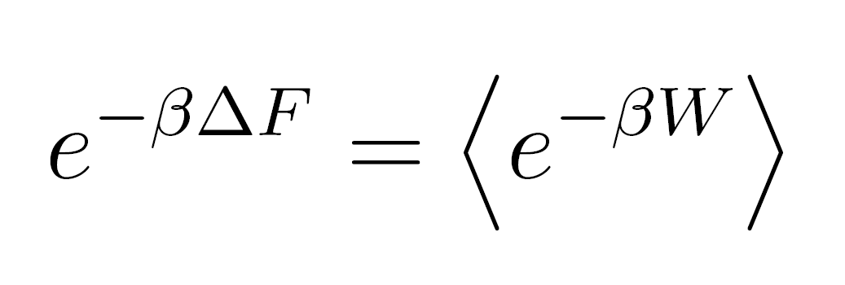
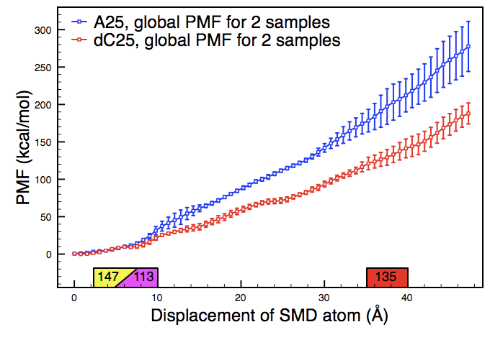
Formalism/Methodology
-SMD
Two major limitations: Time and Computational Resources
Parrallel MD code greatly increases simulation capabilities
Simulation model is ~330k atoms
Various calculations made for all atoms every 2fs
Atomistically detailed simulations of this system are limited to nanoseconds on available machines/budgets
Experimental event in the region of milliseconds
Solution: perform partial translocation at fast speed

Slide 28
Methodology
-SMD
Time-scale problem:
One long running (ms) simulations equilibrium vs multiple shorter non-equilibrium simulations (10ns)
Convert force to work profile. Average of the work profile =~ free energy profile (PMF) according to Jarzynski’s Equality
cv Steered Molecular Dynamics
Repeat N translocation simulations -> take average -> plot energy profile
Use profiles to distinguish homonuclear DNA chain

Slide 29
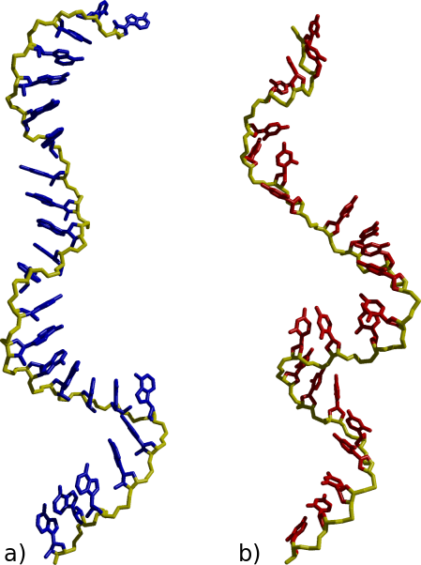
Polynucleotide Translocation Macroscopic Behaviour
Polynucleotide Translocation
Local free energy profiles shows stronger peaks for A₂₅ than dC₂₅
Global profile shows good separation
Rough calculation using global profile shows 25 fold difference in translocation time
Consistent with SCCR
Notes:
Adenosine deoxycitidine

Slide 30
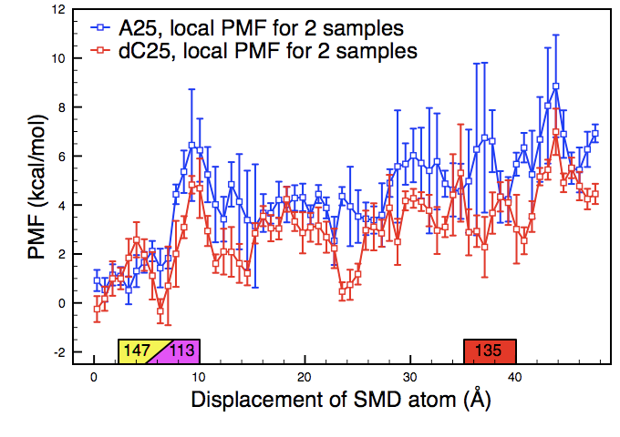
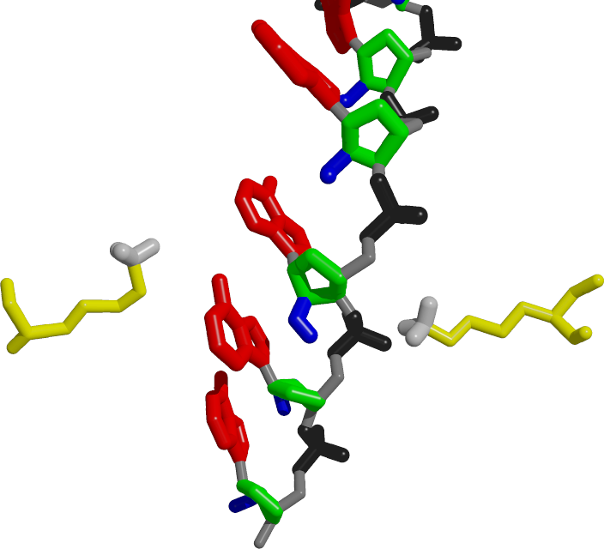
Polynucleotide Translocation Microscopic Effects
Polynucleotide Translocation
Many nucleotides moving past many protein residues makes cause of peaks unclear
Peaks appear to correlate to a phosphate-lysine interaction

Slide 31
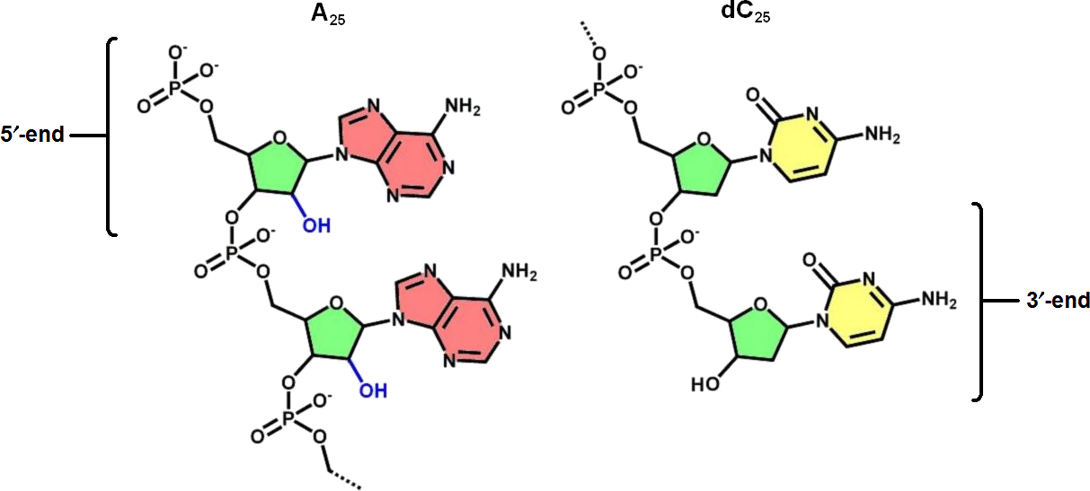
Polynucleotide Translocation (3)
Polynucleotide Translocation
Stronger A₂₅ peaks than dC₂₅ indicate a stronger phosphate lysine interaction
Sterics of adenine may bring phosphate closer to lysine
Hydroxyl group of A₂₅ can be seen to repulse phosphate group
Notes:
Adenosine deoxycitidine

Slide 32
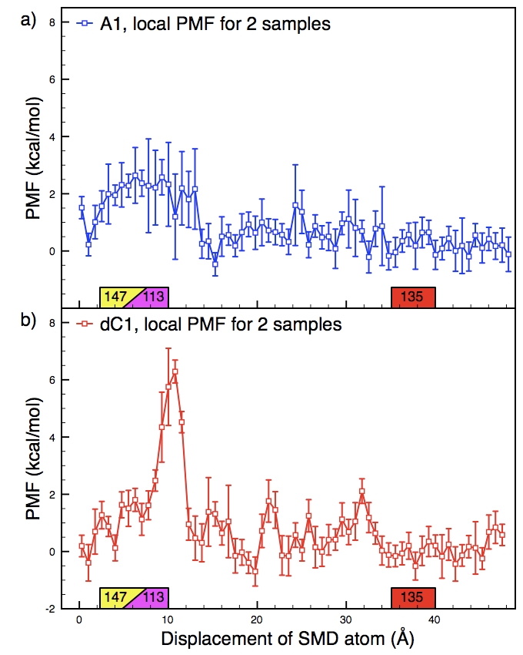
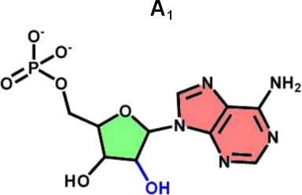
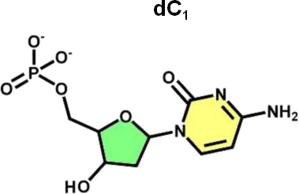
Single Nucleotide Translocation
Single Nucleotide Translocation
Single nucleotide translocation performed to clarify peak contributions
Plots show majority of activity occurs at constriction
dC₁ interaction stronger than A₁, contrary to polynucleotide case:
Collective behaviour weakening

Slide 33
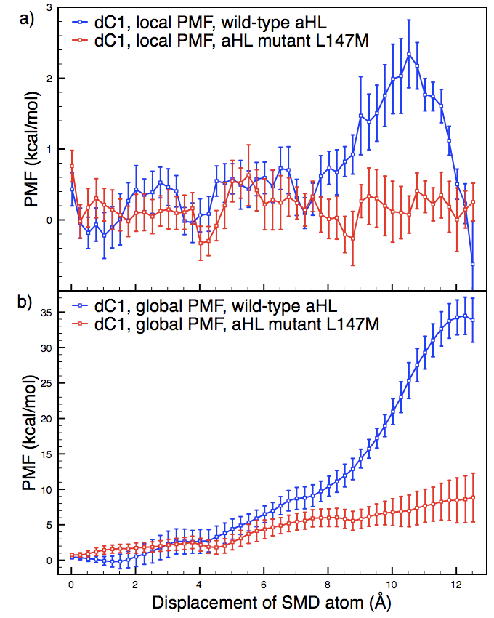
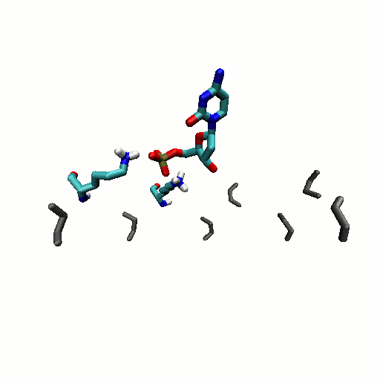
Mutated Nanopore
Mutated Nanopore
Point mutation of Lys-147 (yellow) confirms cause of peaks

Slide 34
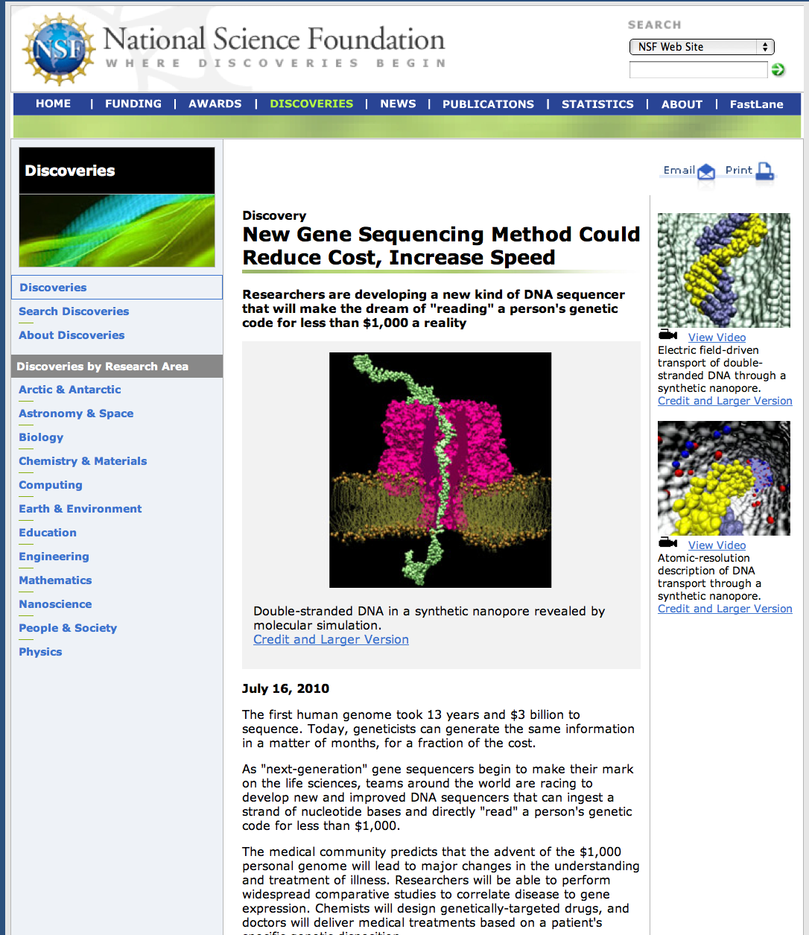
Lessons Learnt: Computing on TG

Slide 35
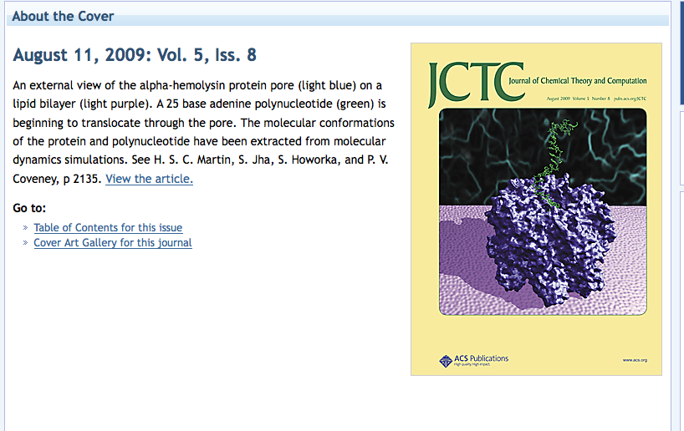
A Pore Man’s View of the TeraGrid
2005-09: TG Did not help manage the “distributed workload”!

Slide 36
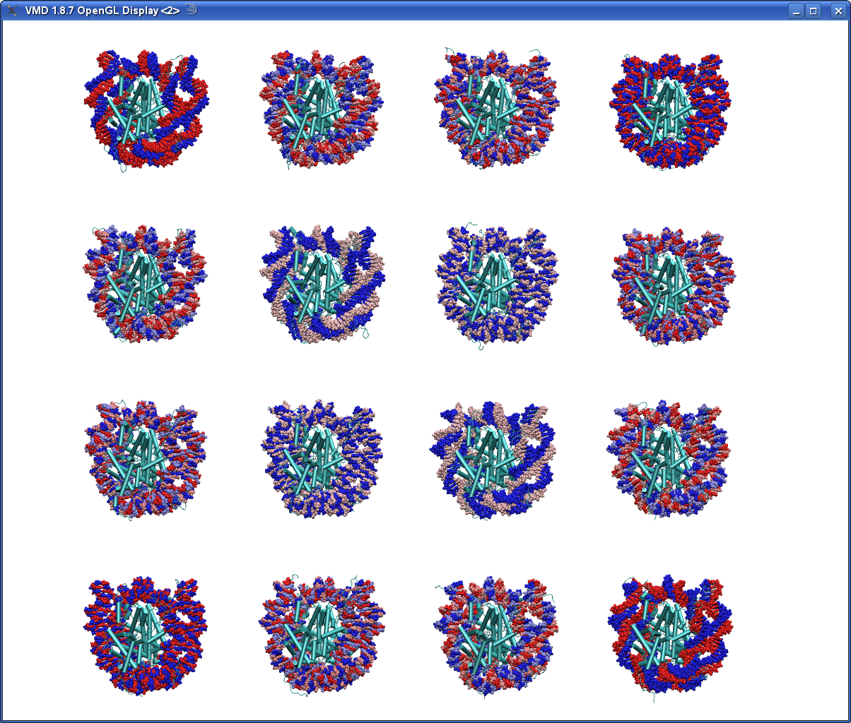
Molecular Dynamics Studies of Nucleosome Positioning Thomas C. Bishop Associate Professor Louisiana Tech University Ruston, LA
Notes:
Remember to the thank the organizing committee
36

Slide 37
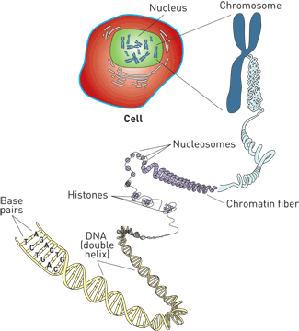
Biology 101
Notes:
Brief review of chromatin session yesterday: DNA folding into nucleosomes; nucleosomes fold into chromatin and chromatin exists in the cell nucleus.
It’s a packing problem. Nucleosomes will fold any sequence but not all sequences are equal. (nucleosome positioning story that was told yesterday)
Nucleosomes are the building blocks of the genome. So fundamentally important to understand their strucuture and dynamics.

Slide 38
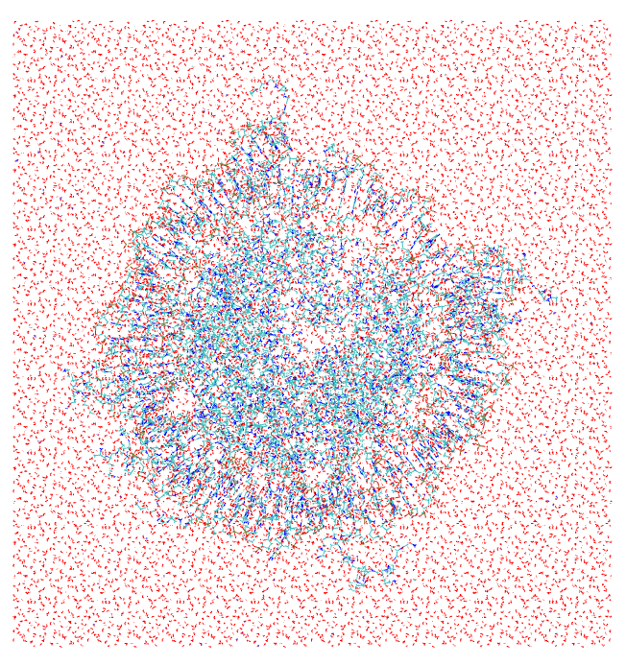
Single Nucleosome Simulation
System size
898 a.a. = 14,567 atoms
147 b.p. = 9,323 atoms
water and ions => 182,124 atoms
total: 206,000 atoms
Simulation Parameters
Amber 99 with bsc
NAMD compute engine
64 cpu => 4ns/day (single GPU)
Trajectories: 200ns
15nm x 15nm x 9.5nm

Slide 39
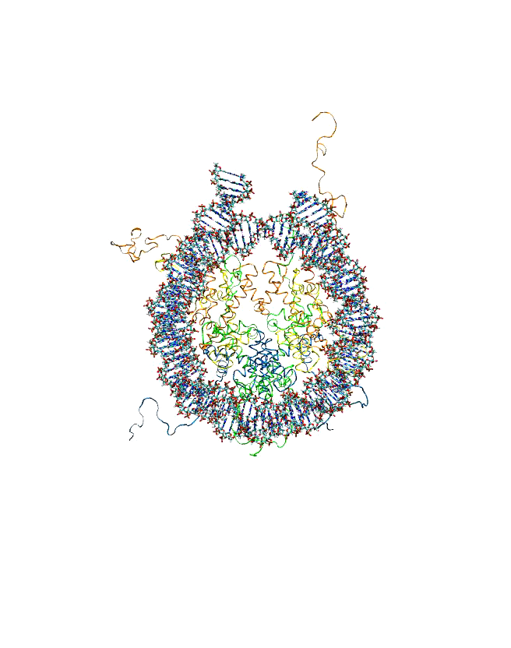
Strategy
Strategy for our Study
All atom MD simulation of 16 X 21 = 336 nucleosomes
Model the 16 most highly occupied and least variable nucleosome positions in Saccharomyces Cerevisiae.
Threading see the MOVIE
Notes:
MD because details matter and only 1-3 sequence available by xray
Curated database of nucleosome positioning for entire yeast genome assembled by Pugh 200??? Based on 6(?) diff. experiments, 2/3 diff. groups, using diff methods. YEAST has 16 chromosomes picked 1 nuc. From each of chromosome.
highly occupied: all experiements agree that very likely exists a nucleosome at this location
Least variables: means all experiements agree on exact location w/in 2-4bp
Strategy is thread thru 10bp upstream (1 helical turn ) 10bp downstream (1 helical turn)

Slide 40
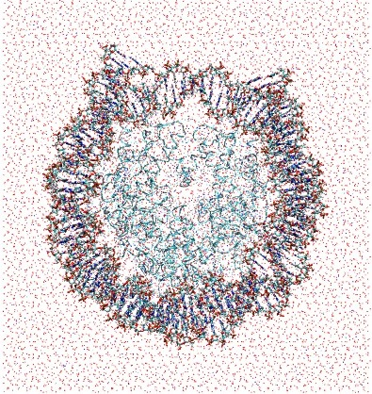
Simulation Challenge
Simulation challenge
System Size
Total: 158,432 atoms
Simulation Time 20ns
Divided into 20 tasks
336 X 20 = 6720 tasks
Input: 52mb
Output: 1ns -> 3.7Gb
FF: Cornell/BSC/
NAMD compute engine/ PME
Total Project 25TB
Total Time: 6 Million Hours and 6,720 ns
13.6nm x 14.5nm x 10.1nm
Notes:
Size
Time
F.F.
Compute engine
COMPUTE TIME 20ns ~ 7000SU/system and 74Gb
total study: 3,000,000 SU and 25TB and 6,720 “tasks”

Slide 41
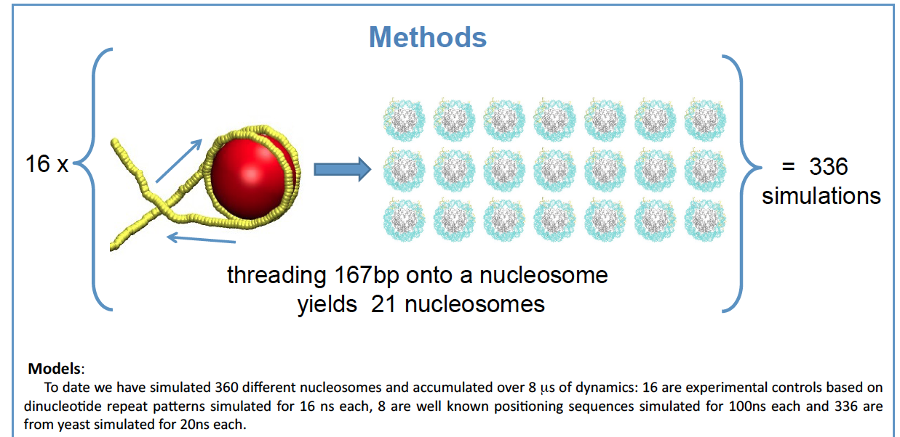
High-Throughput of HPC

Slide 42
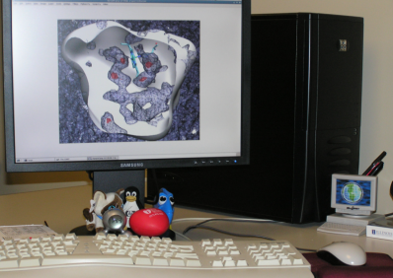
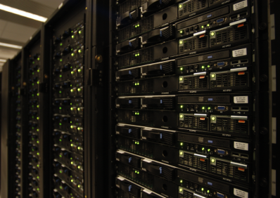
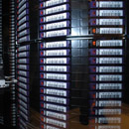
Typical MD “Workflow”
Typical MD Workflow
2. Submit remote batch job
1. Store input files on MSS
Local Workstation
6. Retrieve restart and
output files
3. Retrieve input and restart files
5. Store output and restart files
Mass Storage System
Remote HPC Machine
Notes:
A simulations is a single thread of tasks
To run a simulation is a 6 part process
This works for a few simualtions but need to automate and more resources for 336 systems

Slide 43

SAGA: Programming the Grid?
There exists a lack of Programmatic approaches that:
Provide general-purpose, basic &common grid functionality for applications and thus hide underlying complexity, varying semantics..
The building blocks upon which to construct “consistent” higher-levels of functionality and abstractions
Meets the need for a Broad Spectrum of Application:
Simple scripts, Gateways, Smart Applications and Production Grade Tooling, Workflow…

Slide 44
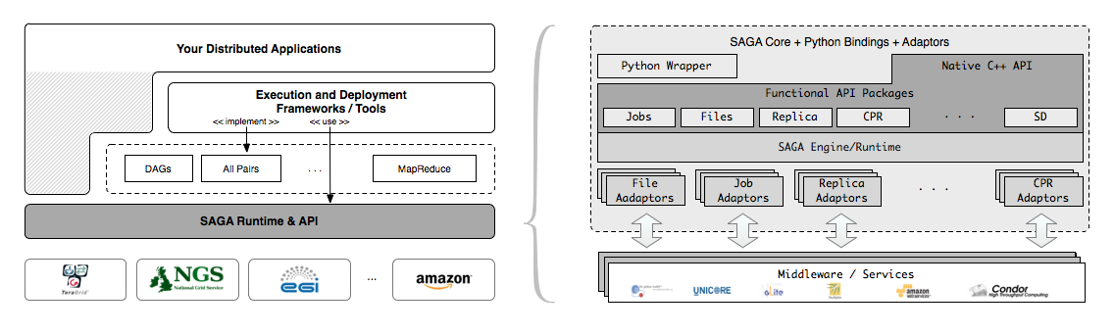
SAGA – An Overview
Simple, integrated, stable, uniform and community-standard
Simple and Stable: 80:20 restricted scope
Integrated: Similar semantics & style across primary functional areas
Uniform: Same interface for different distributed systems
The building blocks upon which to construct “consistent” higher-levels of functionality and abstractions
OGF-standard, “official” Access Layer/API of EGI, NSF-XD

Slide 45
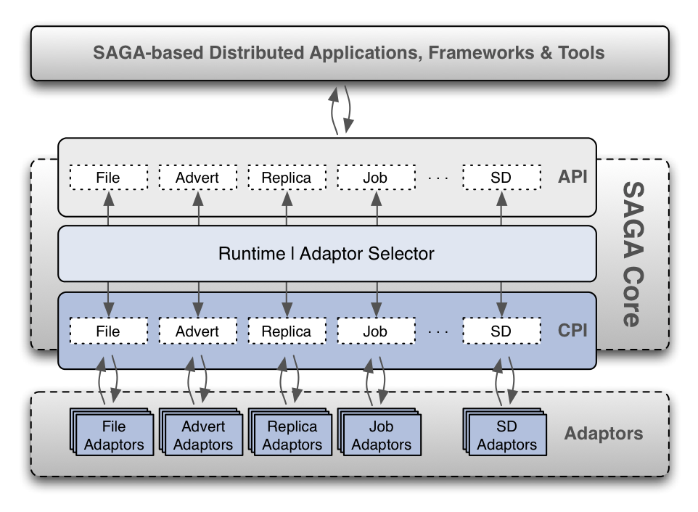
SAGA Architecture

Slide 46
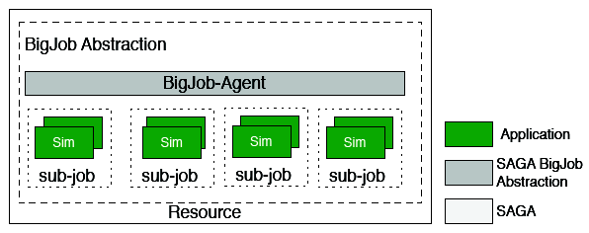
Abstractions for Dynamic Execution (1) Container Task

Slide 47
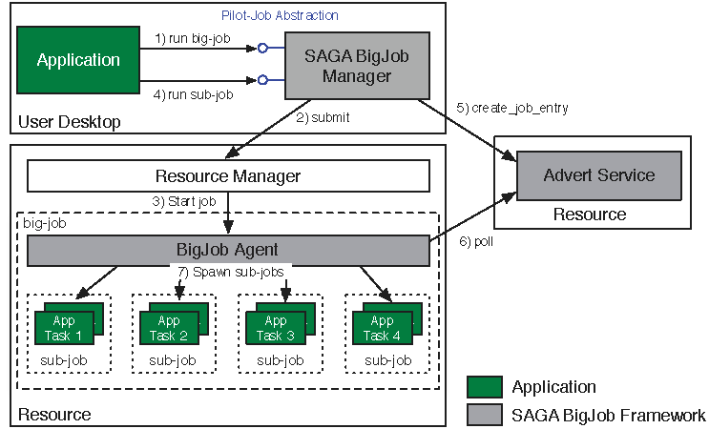
Abstractions for Dynamic Execution (2) SAGA Pilot-Job (BigJob)

Slide 48
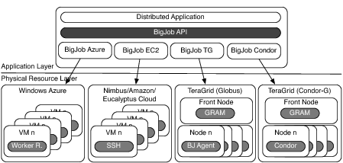
Deployment & Scheduling of Multiple Infrastructure Independent Pilot-Jobs

Slide 49
What is “unique” about Pilot-Jobs built using the right abstractions?
Pilot-Jobs: Decouple resource assignment & resource-workload binding
Pilot-Jobs are/have been typically used for:
Enhancing resource utilization; Facilitate high-throughput simulation
Lowering wait time for multiple jobs (better predictability)
Several unique aspects about the SAGA-based Pilot-Job
Pilot-Jobs have not been used for Science Driven Objectives:
First demonstration of multi-physics simulations, REMD simulations
Frameworks based upon PJs (pull model) for specific back-ends
Infrastructure Independent and “standard” PJ API to access other PJs
SAGA PJ (BigJob) API basis for inter-operable PJ (Azure, DIANE)
SAGA-based Pilot-Job form the basis for
Extension of Pilot-abstraction to other “dimensions”
For autonomic scheduling and application-level scheduling
Advanced run-time frameworks for load-balancing and FT

Slide 50
High-Throughput of HPC (HT-HPC)

Slide 51
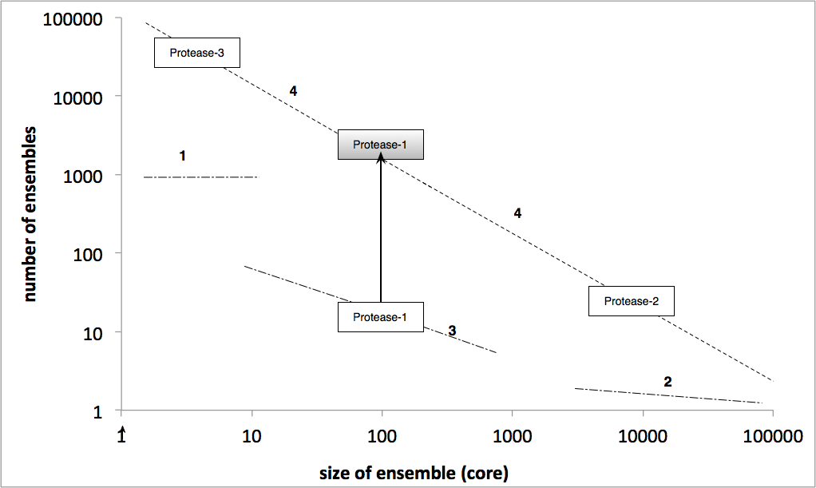
SAGA-based PJ: HT-HPC

Slide 52
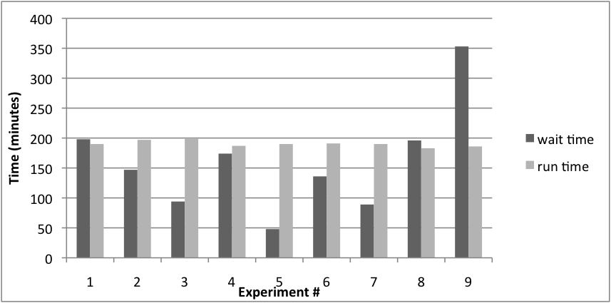
HT-HPC (Kraken)
126 ensembles, each of 192 cores = 24192 cores

Slide 53
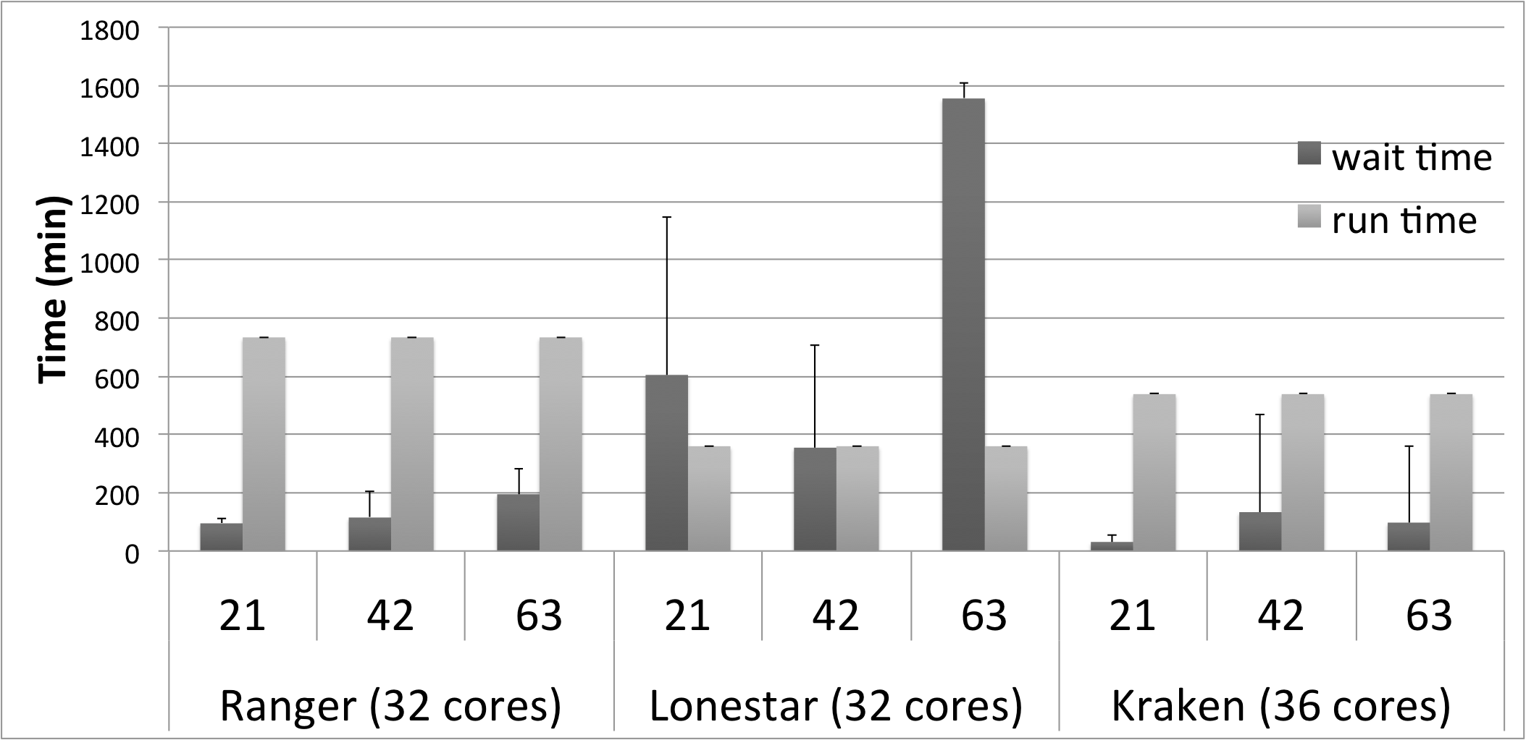
HT-HPC – Distributed (1)

Slide 54

HT-HPC – Distributed (2)

Slide 55


IDEAS: Facilitating Novel Execution Modes
Interoperability and Scale-out enable new ways of resource planning and application execution
Deadline-driven scheduling: e.g., Need Workload X done before time Y
Adapt workload distribution and resource utilization to ensure completion
Accepted for IEEE CCGrid10

Slide 56






Generalized Ensemble Methods: Replica and Replica-Exchange
Sampling is the challenge:
Long run vs multiple short runs?
Task Level Parallelism
Embarrassingly distributable!
Create replicas of initial configuration.
Spawn 'N' replicas over different machine
RE: Run for time t ; Attempt configuration swap. Run for further time t; Repeat till finish
R₁
R₂
R₃
R_{N}
hot
T
t
300K
t
Exchange attempts

Slide 57
RE: Limitations
Simulations and Methodology have been tied to specific implementations and infrastructure
Break the coupling between the development and the underlying infrastructure:
Interoperable: Usage across multiple infrastructure
Extensible -- to new methods of communication and coordination
Scalable
Whither New Distributed Algorithms?
Infrastructure doesn’t support implementation/testing, hence no attempts at algorithmic innovation; hence no pressure on infrastructure!
Challenges at Multiple-Levels
Heterogeneity of environments – coordination and execution
Distributed Coordination Problem: Developing applications that are able to orchestrate heterogeneous resources. RE simulations involve a large number of loosely coupled ensembles

Slide 58
Overcoming RE Limitations
Using abstractions for distributed computing, implement a flexible, extensible and scalable RE capability
Utilizes a range of infrastructure concurrently
Supports different replica pairing/exchanging mechanisms:
Synchronous versus asynchronous and thereby different variants of the RE algorithm
Supports different coordination mechanisms
Implement (i) Synchronous Exchange (ii) Two types of Asynchronous Exchange types
Performance Advantages arise
Logical and physically distributed applications

Slide 59


Distributed Adaptive Replica Exchange (DARE) Multiple Pilot-Jobs on the “Distributed” TeraGrid
Ability to dynamically add HPC resources. On TG:
Each Pilot-Job 64px
Each NAMD 16px
Time-to-completion improves
No loss of efficiency
Time-per-generation is measure of sampling
Adaptive Replica-Exchange,
Phil. Trans of Royal Society A (2009)

Slide 60
Synchronous (Traditional) RE
For the traditional implementation of RE and number of replicas (N), create a fixed set of N/2 pairs of replicas.
When all the replicas reach a pre-determined state, the exchanges are attempted (the exchange step).
If yes, (i.e. exchange is successful), parameters such as the temperature are swapped and replicas are re-started
If not, continue till next exchange
Limitations:
Exchanges can only take place between fixed pairs of replicas; inhibits exchanges between replicas with non-nearest temperatures.
Synchronized exchange steps: Inefficient for heterogeneous infrastructure (i.e., different running times for each replica).
Synchronized exchange step means concurrent (bursty) communication and coordination; does not scale for large N

Slide 61
Asynchronous RE
Implement Asynchronous version of the RE algorithm to overcome the limitations.
Asynchronous RE, replicas can perform exchanges with any other available replica, whenever possible – instead of waiting for all the replicas to finish for a synchronized exchange step
This does not limit exchanges to fixed pairs of replicas. Any two replicas can attempt to exchange.
Experiment with two different async implementations:
Centralized point of decision making & coordination(cent)
A master co-ordinates and manages all the replicas and exchanges [Classical M-W Paradigm]
Decentralized coordination (De-cent)
Each replica is handled independently [akin to P2P..w/ M]
Does this prevent central manager/master from becoming a bottleneck, with large N?
Notes:
What do you mean asynchronously? Elaborate please? How does it eliminate the need to pair replicas?
We do not propose it. It has been already been proposed/implemented. We are trying to implement it using SAGA, which gives us the ability to test/implement on large-scale production infrastructure

Slide 62
Control Flow – Asynchronous RE Centralized
Notes:
Control flow of what?

Slide 63
Control Flow – Asynchronous RE Decentralized

Slide 64
Experiments
We implemented the following:
Synchronous RE
Case I: Synchronous (centralized) RE
Asynchronous RE
Case II: Asynchronous RE (centralized)
Case III: Asynchronous RE (decentralized)
Compare the three cases for:
Scale-Up – with increasing N_{R}
On a single resource
Scale-Out - Distributed Performance
Performance with increasing number of resources
Heterogeneous Resources
Crosswalks and Temperature Mixing

Slide 65
Scale-Up Experiment Configurations
All cases use a parallel NAMD simulation with 4, 8, 16, 32, 64, 128 and 256 replicas on QueenBee, a LONI/Teragrid machine. (128 and 256 replicas were run on Ranger, but the results normalized)
The ratio between the number of replicas and the number of exchanges is kept constant, for the purpose of comparison.
Each replica uses 16 MPI processes and runs 500 time steps between exchange attempts.
Single BigJob launched with sufficient number of cores
The metric used is the time to complete a particular number of exchanges. Ignore wait times!
Each experiment has been repeated approx. 10 times

Slide 66

Scale-Up (on QB)

Slide 67
Analysis
The ratio between the number of replicas and the number of exchanges is kept constant
Ideally the runtime should be constant too
As N_{R} increases performance variation for 3 cases
Asynchronous RE scales better with a large number of replicas and resources. The decentralized asynchronous RE beats the centralized version.
In synchronous RE, the overhead of managing a large group of replicas at each exchange step causes the degradation
In asynchronous RE – centralized, the centralized implementation becomes a bottleneck with more number of replicas.
The decentralized implementation scales well even with a large number of replicas.

Slide 68
Scale-Out Experiment Configurations
All cases use a parallel NAMD simulation with 8, 16 and 32 replicas on 1, 2 and 4 machines.
The ratio between the number of replicas and the number of exchanges is kept constant, for the purpose of comparison.
Everyt ime 4 BigJobs are launched.
Each replica uses 16 MPI processes and runs 500 time steps between exchange attempts
The metric used is the time to complete a given number of exchanges.
Only those experiments in which all the BigJobs start at the same time are included in the results. Therefore, wait times can be ignored.
Each experiment has been repeated at least 5 times

Slide 69

Scale-Out – Synchronous
Notes:
Use this or 20 or 18.

Slide 70

Scale-Out – Asynchronous - Decentralized

Slide 71
Analysis
Synchronous: Distributed runs take longer than the local run. There are two reasons:
Remote file staging takes longer.
Even in the case of homogeneous resources, it takes longer to synchronize all the replicas at every exchange step. (because NAMD runtime is not always constant)
Even if it were possible to implement distributed synchronous RE without remote file staging, the algorithm still effects the performance negatively due to synchronization at each exchange step.
Asynchronous RE:
Centralized:
distributed runs take slightly longer due to the remote file staging.
Decentralized: in the decentralized implementation the remote file staging is replaced with exchange of data via the advert server.
Distribution of resources does not effect the performance in general.
Unless the resources are so far away that the communication times are adversely effected.
Notes:
NAMD runtime does not remain constant when the number of cores and timesteps is kept constant. It has a delta of +/- 3 seconds.

Slide 72
Heterogeneous Resources
Heterogeneity in the resources can effect the performance.
Artificially introduced heterogeneity in the resources.
Different replicas assigned different number of processors.
32 replicas launched to do 128 exchanges.
16 replicas assigned 16 processors, 8 replicas assigned 8 processors.
Machines used: QB, each experiment repeated 5 times.

Slide 73

Heterogeneous Resources

Slide 74
Heterogeneous Resources: Analysis
Average run time of NAMD on 16 processors is approx. 71 seconds and on 8 processors it is approx. 112 seconds.
In synchronous RE all replicas were made to wait for other replicas to finish running, which added approx. 328 s to the total time to completion.
In the asynchronous RE, the performance advantage of the faster replicas was retained.
Heterogeneity comes in different ways – processors, network, communication times, etc.
We only looked at how heterogeneous processors effect

Slide 75
Crosswalks and Temperature Mixing
Crosswalks: said to occur when a replica transitions from a lower temperature region to a higher temperature region and back.
Other publications have already proved that more crosswalks occur in the asynchronous RE.
We will look at the temperature mixing in the two algorithms.
We modeled the 2 algorithms to get the results.
Each experiment repeated 5 times.

Slide 76

Temperature Mixing

Slide 77
X-Walk and Temp Mixing: Analysis
Average total number of exchanges per replica is always higher in the case of asynchronous RE.
In the synchronous RE, some times the replicas do not find partners with neighboring temperatures.
Average number of unique exchanges per replica:
More or less equal when N_{R} is small.
Higher in the case of asynchronous RE as the number of replicas increase.
Difficult for the replicas in synchronous RE to traverse large number of replicas making exchanges.

Slide 78
Overview
Introducing Production Distributed CI
Formalisms, Infrastructure and Algorithms
Formalism: Scale-Out AND Scale-Up
SPICE: Configurational Sampling & Free-energy Calculations
Infrastructure: MD Studies of Nucleosome Positioning
HT-HPC, SAGA and Pilot-Jobs
Algorithms: Adaptive Replica-Exchange
Other Examples:
Personalized and Predictive Medicine
Personalised Health: Interactive (Steering) Supercomputing
Personalised HIV Treatment
Distributed Data-Intensive Biological Applications
Supporting Next Generation Sequencing (NGS) Analytics
Notes:
Delicate balancing act: --- vision of the future but rooted in reality – with rigorous research.
Be sure to define “applications” – eScience, scientific applications…

Slide 79



GENIUS: Clinical Supercomputing Diagnosis and decision support in surgery
Provide simulation support from within the operating theatre for neuroradiologists
Provide new information to surgeons for patient management and therapy:
Diagnosis and risk assessment
Predictive simulation in therapy
Provide patient-specific information which can help plan embolisation of arterio-venous malformations, coiling of aneurysms, etc.
Notes:
New - unavaiable information, pressure,s stress etc.

Slide 80


Patient Specific Aneurysms
Images by Marco Mazzeo (UCL)

Slide 81


HIV Protease
HIV-1 Protease is a common target for HIV drug therapy
Enzyme of HIV responsible for protein maturation
Target for Anti-retroviral Inhibitors
Example of Structure Assisted Drug Design
9 FDA inhibitors of HIV-1 protease
So what’s the problem?
Emergence of drug resistant mutations in protease
Render drug ineffective
Drug resistant mutants have emerged for all FDA inhibitors
Monomer B
101 - 199
Monomer A
1 - 99
Glycine - 48, 148
Flaps
Saquinavir
P2 Subsite
Catalytic Aspartic Acids - 25, 125
Leucine - 90, 190
C-terminal
N-terminal

Slide 82


Resistance Causing Mutations
Protease inhibitors
RT inhibitors
Mutations at many positions affect resistance
The HIV genome can accommodate many mutations
Mutations interact to produce resistance
Too many mutations for clinicians to interpret
Support software is used to interpret genotypic assays from patients

Slide 83
The Challenge of Integrating Compute and Data CI
“There is a growing gap between the generation of massively parallel
sequencing output and the ability to process and analyze the resulting data. New users are left to navigate a bewildering maze of base calling, alignment, assembly and analysis tools with often incomplete documentation and no idea how to compare and validate their outputs. Bridging this gap is essential, or the coveted $1,000
genome will come with a $20,000 analysis price tag."

Slide 84
CI/HPDC Challenges for NGS Analytics
What is the optimal cyber-infrastructure configuration?
No well-defined single infrastructure configuration or capabilities
Distinguish: Astronomy, HEP community
Integrated Compute and Data CI at unprecedented scales
“Building this infrastructure is not trivial” (Fox)
Need both Development and System/Infrastructure level abstractions
There are “hard” parts and tractable parts
Use of standards and middleware integrated with resources handles the hard part, opening up innovation elsewhere
“Clouds are the natural CI for NGS” !?
Data localization model scalable? sustainable?
How and when to move compute to data (or vice-versa)?
What are the data transfer/access/storage mechanisms

Slide 85
The case for Gateways and HPDC
Observation I
Using local compute resources and data storage is too limited.
Observation II
Users need a pathway from local to National CI
Need for Campus Bridging
Observation III
Using Supercomputers or HPC resources is difficult and complex
Gateways: “Community-based” Solution
“Expert” configure, optimize once: Multiple users/usage
Hiding the complexity of using distributed HPC resources and emerging cloud environment.
Gateways: fastest growing access mode/mechanism on XSEDE

Slide 86

DARE-based Science Gateways (I)
http://dare.cct.lsu.edu/gateways/ngs
Three levels:
Access/Application Layer
Services & MW Layer
Resource Layer
Application/Access Layer
Extensible and flexible
Standard-based middleware and services
OGF Standard and official access layer of NSF XSEDE
Resource Level
Extensible + Interop
Notes:
Fixed the diagram.. Please remove next slide if you are OK with this

Slide 87
ChIP-seq analysis of the NR4A nuclear receptor transcription factor in C. elegans
Chris R. Gissendanner, Ph.D.
Dept. of Basic Pharmaceutical Sciences
ULM College of Pharmacy

Slide 88
Summary
Computational Biology: Driver of computing in all its
Strong interplay of Scientific problem, formalism, algorithms and CI for Computational Biology
Application formulation and development must be less dependent on infrastructure & provisioning details
Richness in space of distributed application
Integrated approach to distributed applications and CI
CI has to be guided by Dist. Application Requirements
Infrastructure capabilities & policy determine app types
Ability to formulate applications and methods that can exploit the underlying CI in novel ways
Propose first-principles design objectives: IDEAS
Extending legacy, static exec. models to dynamic and adaptive composition of applications. Support Scale-UP and Scale-OUT -- More than simple HPC vs HTC, or HTC of HPC

Slide 89
Acknowledgements
Science Collaborators: Tom Bishop, Peter Coveney
PhD Students: Hugh Martin , Wei Huang
SAGA D&D: O Weidner, A Merzky, A Luckow, L Lacinski, Yaakoub el-Khamra, M Santcroos, , S. Maddideni,
Students: C & M Miceli, K Stamou, A Thota, A Zebrowksi
Post-docs: J Kim, Jeff, N. Kim, O Kenway, Dave Wright
Google SoC: Saurabh Sehgal, Miklos Erdelyi,
DPA: D Katz, Murray Cole, Manish Parashar, O Rana, J Weissman
UCL: Steve Manos and Hugh Martin
Fareed Aboul-ela, Cybertools, Many other Collaborators

Slide 90


Acknowledgements
NSF (HPCOPS, Cybertools)
NIH (INBRE, LaCATS)
UK-EPSRC (UK EPSRC: DPA, OMII-UK , OMII-UK PAL),
SAGA, CyberTools and DPA Team

Slide 91
Distributed Data-Intensive LS Applications CI for Distributed Data-Intensive
Challenge I: Compute over inherently distributed data
Distributed DIA: Not just the simple sum of DIA concerns
Challenges: coordination, task-data decomposition, load-bal & dist.
Move compute to data? Or data to compute? Or both?
Support Distributed D-C Affinities
Ensemble-based Molecular Dynamics simulations
Challenge II: Multiple, Heterogeneous Infrastructure
Decouple Application Development from underlying infrastructure
Scale-out (and not just Scale-up)
Interoperation, e.g., weak v strong, concurrently cross Grid-Clouds, DFS
Challenge III: Support dynamic and flexible execution
Support Multiple Programming Models
Master-Worker, but Irregular; MapReduce: File vs stream
Support data-access patterns

Slide 92
Simulation of Blood Flow in Human Arterial Tree
B Boghosian, P Coveney, S Jha et al, Cluster Computing, Vol. 10, No. 3, 351-364 (2007,) DOI 10.1007/s10586-007-0029-4 Courtesy George Karniadakis (Brown)

Slide 93


GENIUS: Supporting Clinical Supercomputing
Issues of Co-Scheduling and Availabilty; imaging data tx quickly over high-bandwidth low-latency dedicated links.
Interactive simulations and real-time visualization for immediate feedback. Uses RealityGrid Steering System (2002-2005)
15-20 minute
turnaround

Slide 94














VPH- I FP7 projects
Industry
Parallel VPH projects
Grid access CA
CV/ Atheroschlerosis IP
Liver surgery STREP
Breast cancer/ diagnosis STREP
Heart/ LVD surgery STREP
Osteoporosis
IP
Oral cancer/ BM D&T STREP
Networking NoE
Cancer STREP
Heart /CV disease STREP
Vascular/ AVF & haemodialysis STREP
Liver cancer/RFA therapy STREP
Alzheimer's/ BM & diagnosis STREP
Heart /CV disease STREP
Other
Security and Privacy in VPH CA
Clinics
Notes:
The Virtual Physiological Human is at the heart of the VPH projects.
STREPs – Specific targeted research projects
FP6 STREPs (Specific Targeted Research Projects) are either projects designed to gain knowledge or improve existing products, processes or services, or demonstration projects to prove the viability of new technologies. STREPs can also be characterized by the implementation of these two types of activity (R&D and demonstration
IP s – Initiative projects
CA’s – Coordination action

Slide 95


Enhancing Decision Support
Inhibitory Drugs
Ranking of drug binding affinities
Simulation
WT & mutant enzymes
Aim: Generate models that can predict the resistance levels of specific enzyme sequences
Cheaper than experiments
Provide insight into the atomistic causes of resistance
Aim: towards patient specific clinical decision

Slide 96



Slide 97

Biology: The Next Big Driver of Computing?
1 January 2010 Vol 327 Science, Issue 5961, Pages 36-37
Francis Collins,
Director NIH
Applying high throughput technologies
Translating basic science discoveries into new and better treatments
Benefiting health care reform
Prevention and personalized medicine
Health disparities research
Pharmacogenomics
Health research economics
Focusing on global health

Slide 98

Replica-Exchange Simulations
Replica-Exchange (RE) methods:
Represent a class of algorithms that involve a large number of loosely coupled ensembles.
RE simulations are used to understand a range of physical phenomena
Protein folding, unfolding etc
Monte Carlo simulations
Many successful implementations
Eg folding@home [replica based]

